Slide 1

WEBSITE OF LAW FIRM MANAGEMENT SYSTEM
Supervisor: Mr. Nguyễn Văn Sang
SE60744 Lê Duy Hoàng
SE60595 Đặng Nguyễn Khiêm
SE60631 Trần Anh Tuấn
SE60634 Phạm Văn Duy

Slide 2

PRESENTATION OUTLINE
Project overview
Software specification
Software design
Project result
Demo
Project management
Testing

Slide 3

Problem
Solution
Idea
PROJECT
OVERVIEW

Slide 4

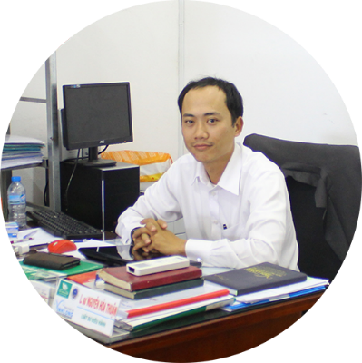

Problem
This project get requirements from "Thuan Nguyen Lawyer Office" in Vinh Long City. The majority of this project is to use internal systems used to manage Office, Service, Staff, Customer, Case Management, Consulting, Contract and Reports…
Existing solution is to go for the actual project, met the manager of law office, Mr. Thuan. And then get actual requirements for project.
Manager of

Slide 5
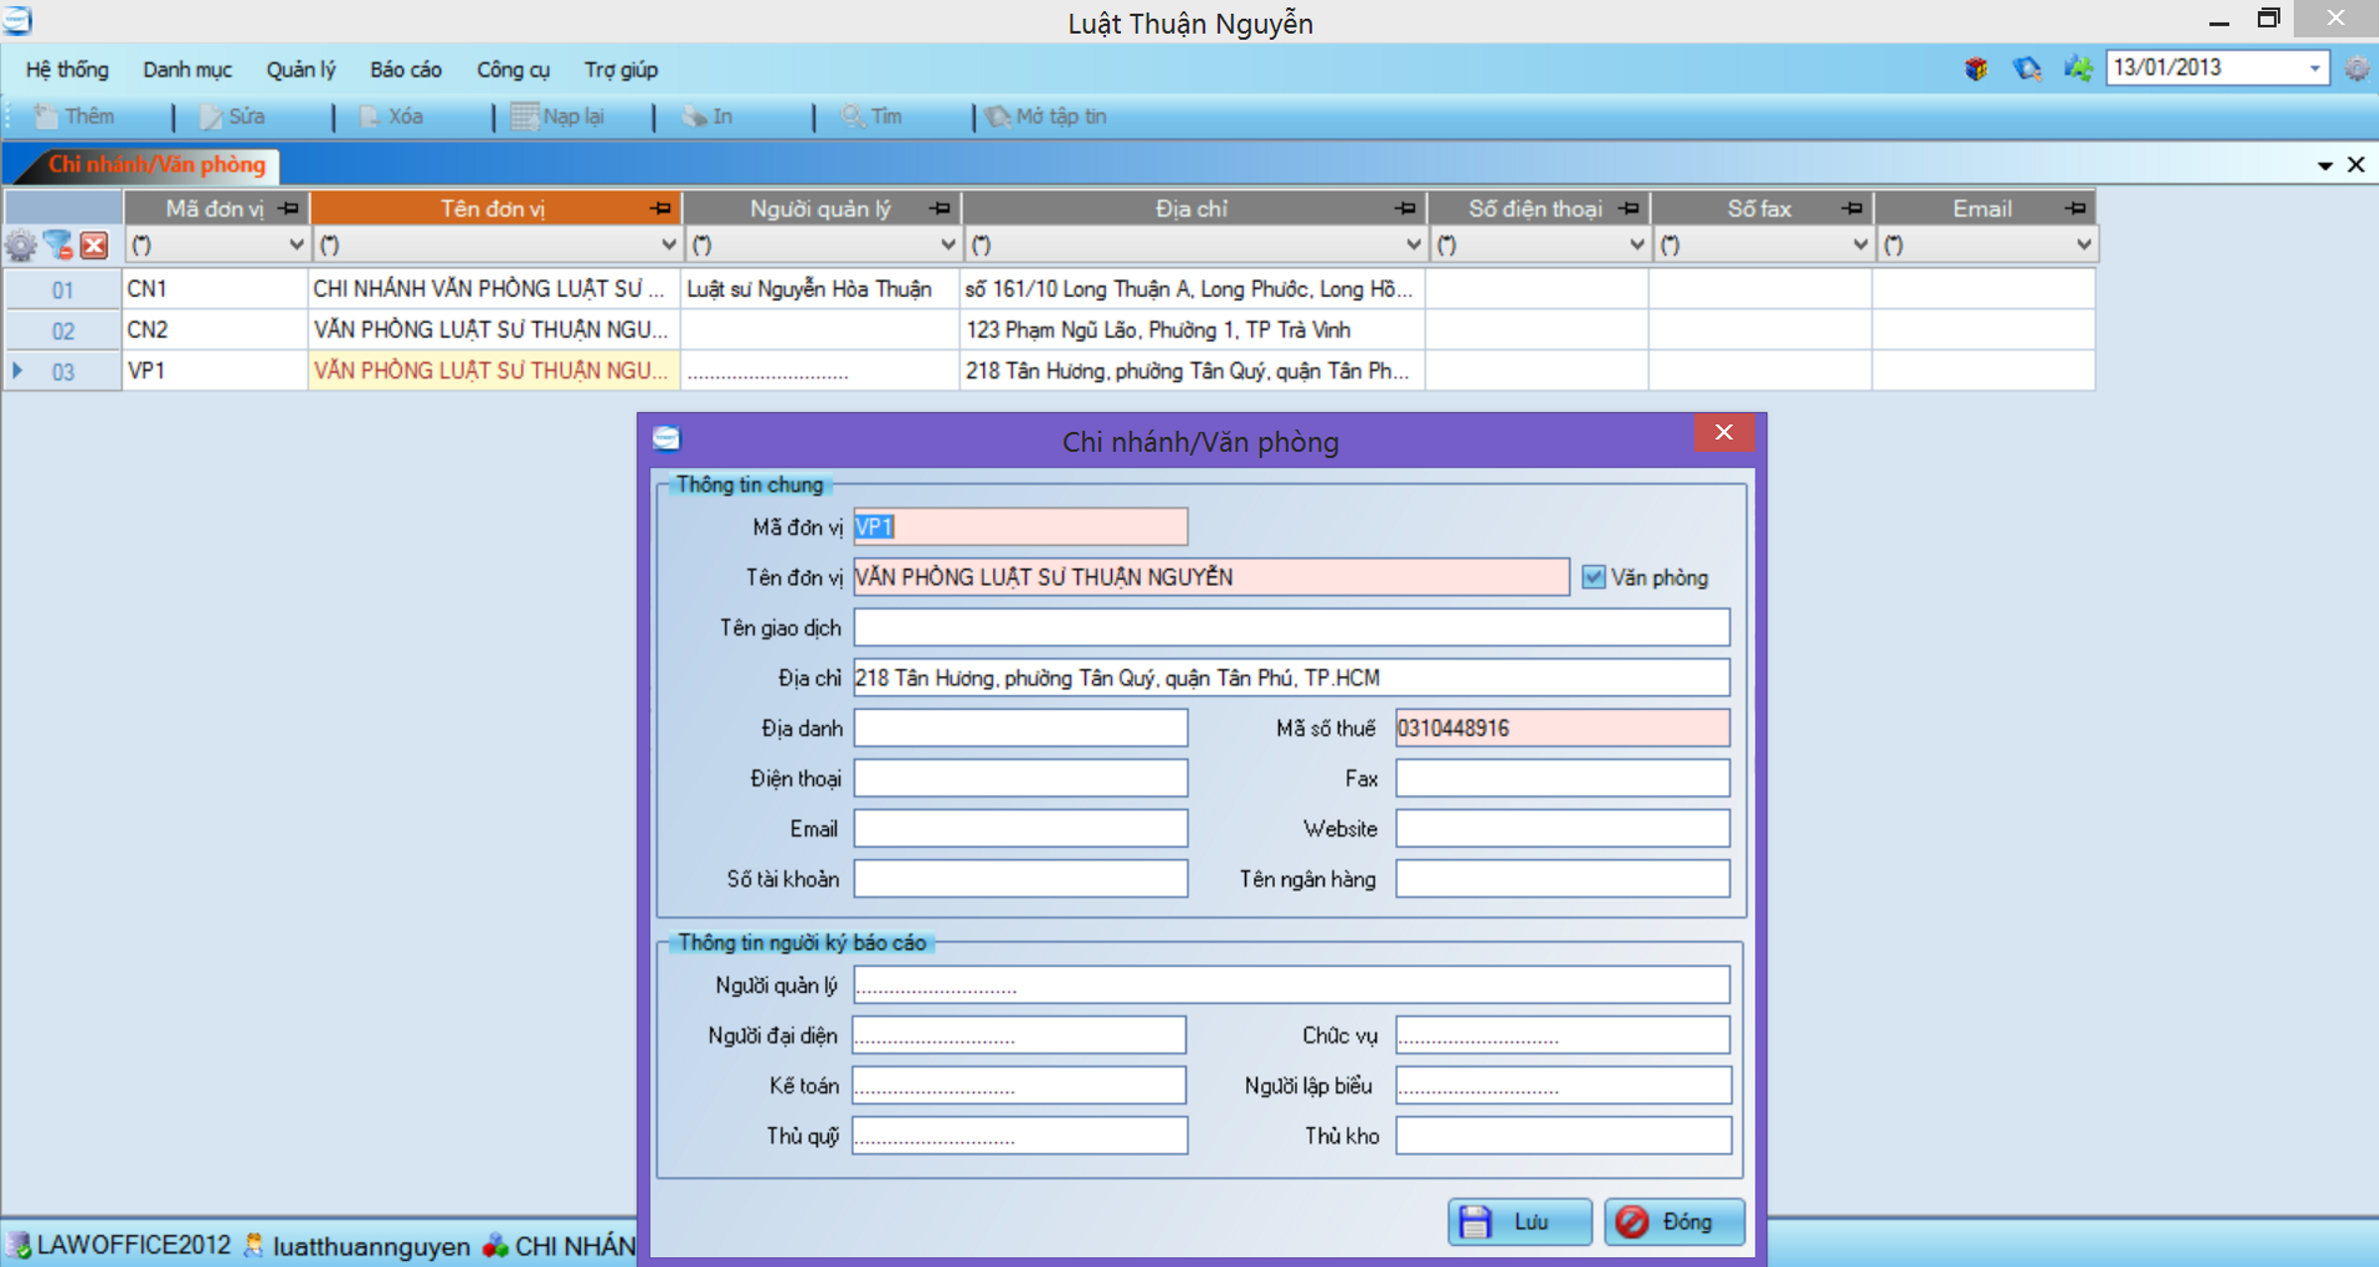
Problem

Slide 6





Problem
Many errors occur
Difficult to upgrade or maintain
Limit number of devices can use
Manage only 1 office
Manage with only text information

Slide 7

Idea
Steady running
Easy upgrade and maintenance
Multiple devices can use at the same time
Can be used for many types of office
Manage multimedia data

Slide 8
Solution
Create a new website build on ASP.Net MVC 4, Entity Framework(EF) 5, Ajax, Jquery etc …
It has main features of existing website such as easy to manage than traditional methods, online data storage and centralized etc…
Lawyers can work more effective, easier and simpler way without remember schedule and operation event.
Law firm can manage all information like case, customer, staff service and office easier.
Accounting easier with auto statistical in every year.

Slide 9
Project Model
Organization Structure
Master Schedule
Deliverables
Tools & Environment
Project Life cycle
Objectives
PROJECT
MANAGEMENT

Slide 10
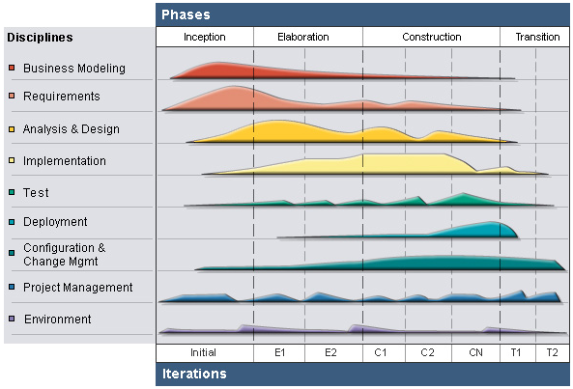
Project Model
RUP Model

Slide 11

Project Model
Why choose RUP?
Develop iteratively
Supports an iterative approach to development that addresses the highest risk items at every stage in the lifecycle, significantly reducing a project’s risk.
Very important for inexperienced team in controlling issues like us.
Manage requirements
Managing requirements during the whole development process ensures project team develops the right system with right requirements

Slide 12
Project Model
Why choose RUP?
Verify software quality
Testing process is implemented in all the cycles of application development time
Reduce risks

Slide 13
Project Life Cycle
Study business case and feasibility study of project
Complete draft ERD of system
Inception
Complete draft screen prototypes
Complete draft requirements
Determine project scopes
Complete project management plan

Slide 14
Project Life Cycle
Complete user requirement specification
Elaboration
Complete software requirement specification
Complete ERD, final prototypes
Complete database model
Complete system architecture design

Slide 15
Project Life Cycle
Complete coding and unit test
Construction
Complete functional and regression test
Complete user manual
Transition
Deploy website
Deliver source code
Complete all reports and documents

Slide 16
Organization Structure
Project Manager
HoangLD
QA Team
HoangLD
Test Team
TuanTA
Develop Team
HoangLD
KhiemDN
HoangLD
DuyPV
TuanTA
TuanTA
HoangLD
DuyPV
KhiemDN
SRS Analysis Team
KhiemDN
Design Team
DuyPV
Supervisior
Mr. SangNV
DuyPV
HoangLD
TuanTA
HoangLD
DuyPV
KhiemDN

Slide 17
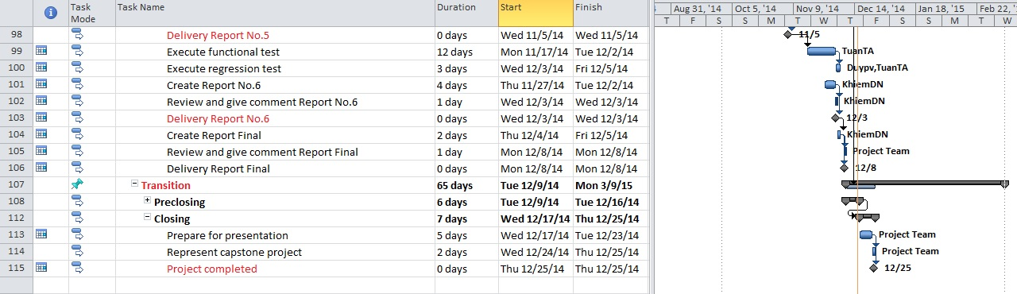
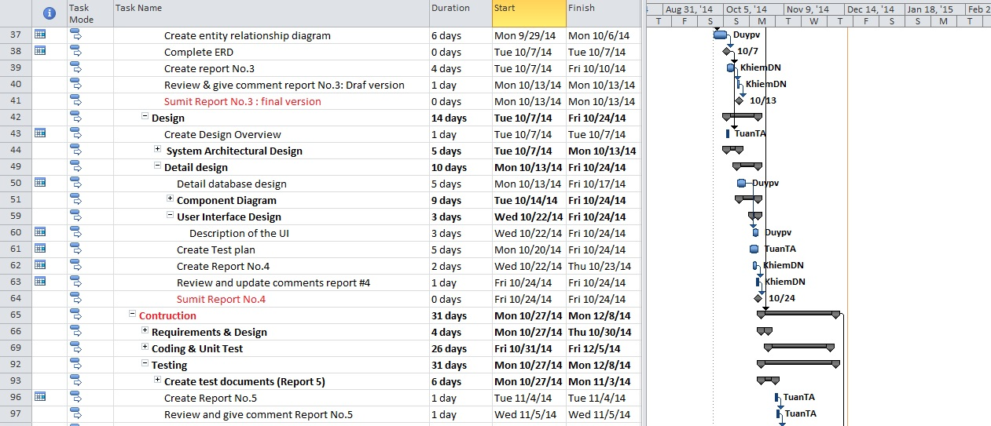
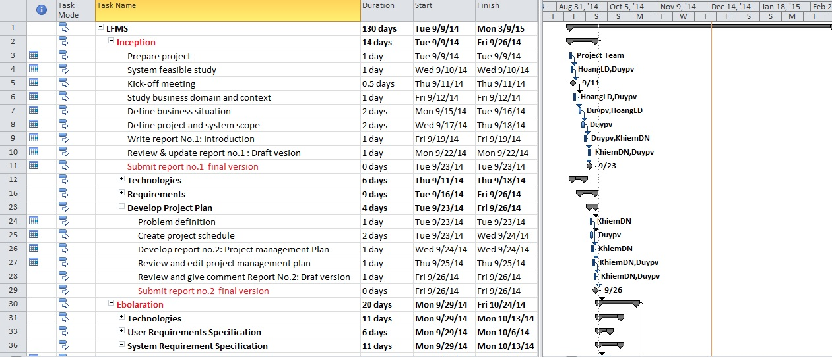
Master Schedule

Slide 18
Objectives
Metrics | Unit | Committed | Actual | Deviation
Start Date | dd-mm-yyyy | 09-09-2014 | 09-09-2014 | 0 days
End Date | dd-mm-yyyy | 25-12-2014 | 25-12-2014 | 0 days
Duration | Elapsed days | 100 days | 100 days | 0 days
Maximum Team Size | Person | 4 | 4 | 0

Slide 19
Deliverables
No | Stage | Deliverable/ Milestone | Delivery Date | Delivery Location
1 | Inception | Deliver Report No.1 | 23-09-2014 | Supervisor
2 | Inception | Project plan | 26-09-2014 | Supervisor
3 | Inception | Deliver Report No.2 | 26-09-2014 | Supervisor
4 | Elaboration | Deliver Report No.3 | 13-10-2014 | Supervisor
5 | Elaboration | Deliver Report No.4 | 24-10-2014 | Supervisor
6 | Construction | Complete Coding | 5-12-2014 | Supervisor
7 | Construction | Deliver Report No.5 | 5-11-2014 | Supervisor
8 | Construction | Deliver Report No.6 | 3-12-2014 | Supervisor
9 | Transition | The last Document and CD source code | 16-12-2014 | FU
10 | Transition | Project completed | 25-12-2014 | FU

Slide 20









Tools & Environment

Slide 21

System Overview
Functional Requirement
Non Functional Requirement
SOFTWARE
SPECIFICATION

Slide 22
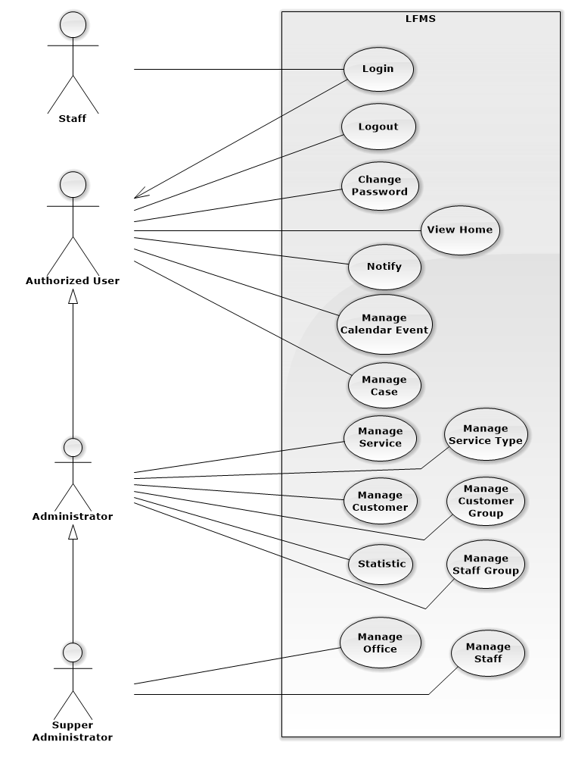
System Overview

Slide 23
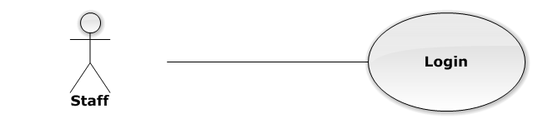
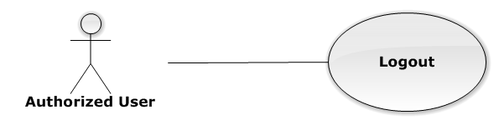
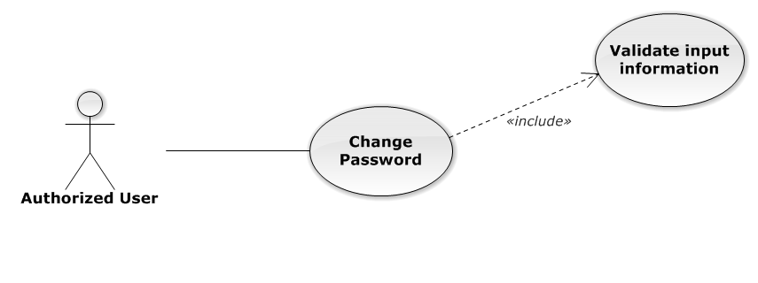
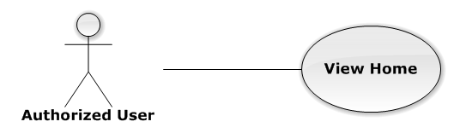
Functional Requirement
Login
Logout
Change password
View home

Slide 24
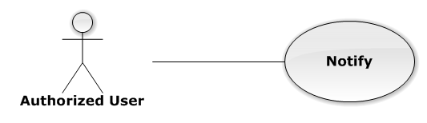
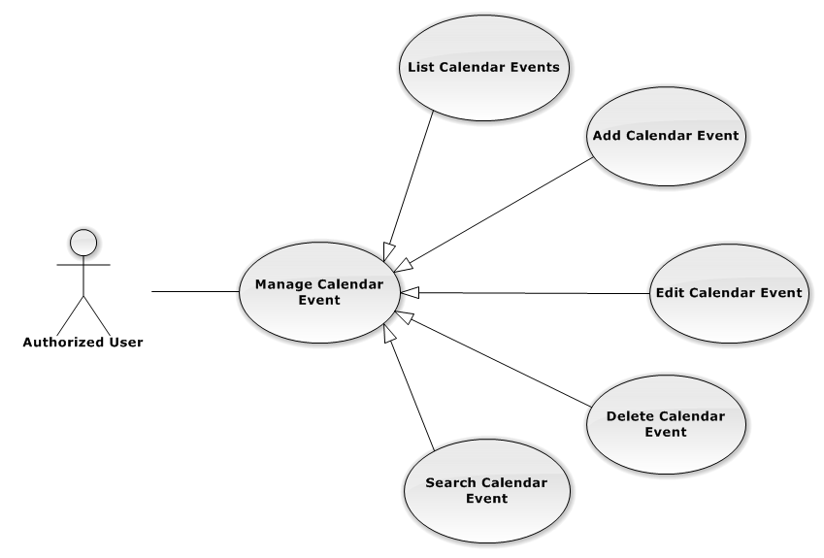
Functional Requirement
Notify
Manage Calendar Event

Slide 25
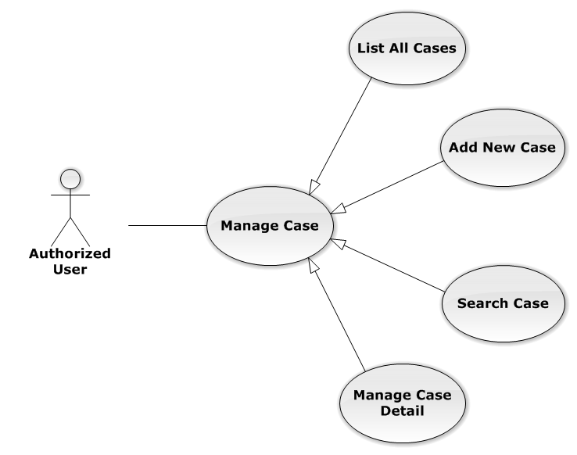
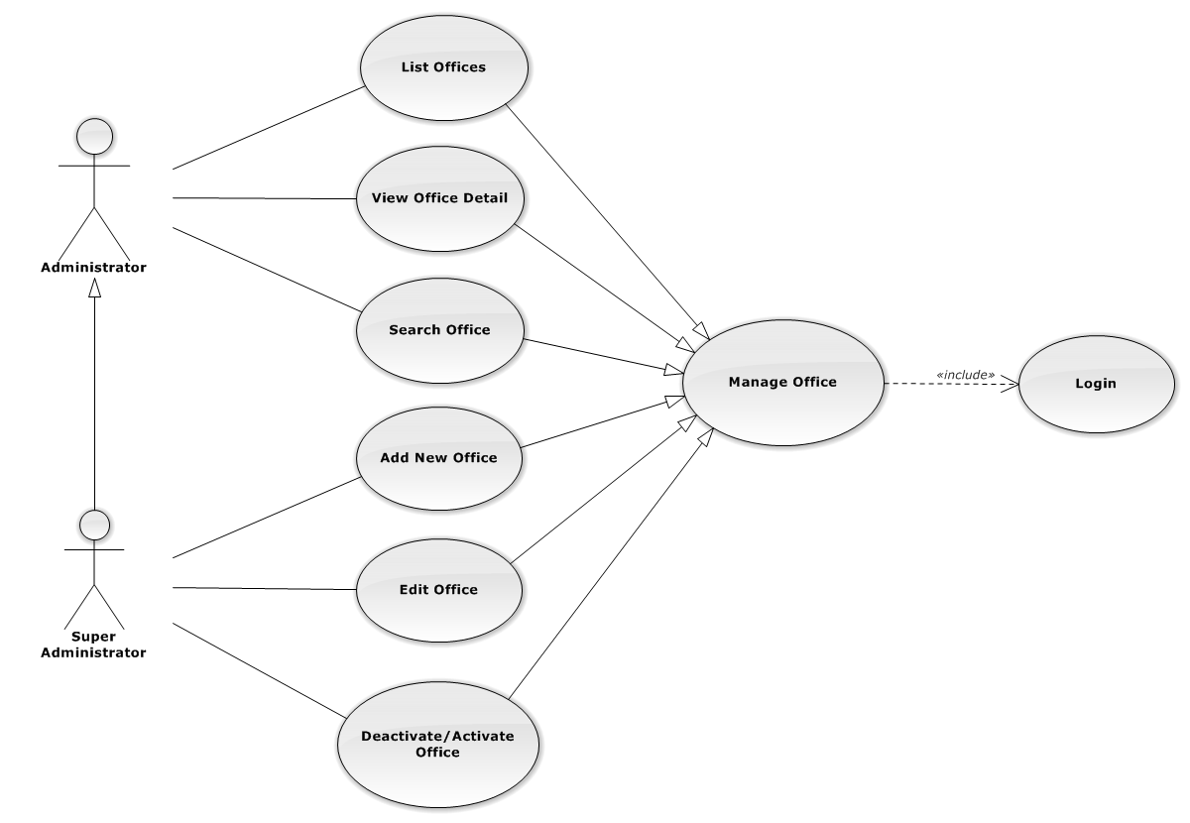
Functional Requirement
Manage Case
Manage Office

Slide 26
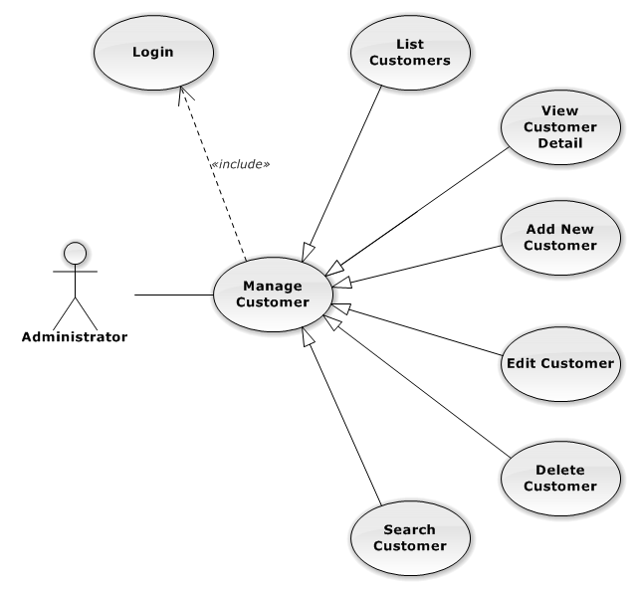
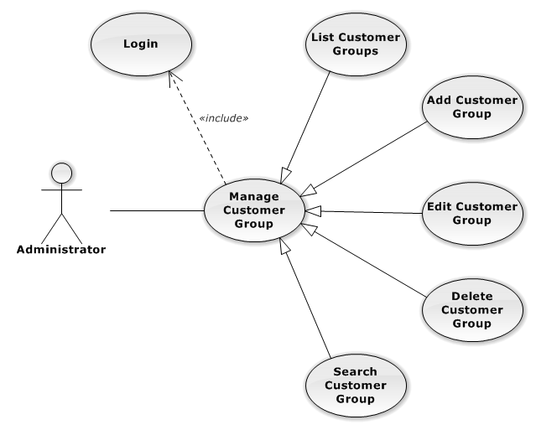
Functional Requirement
Manage Customer
Manage Customer Group

Slide 27
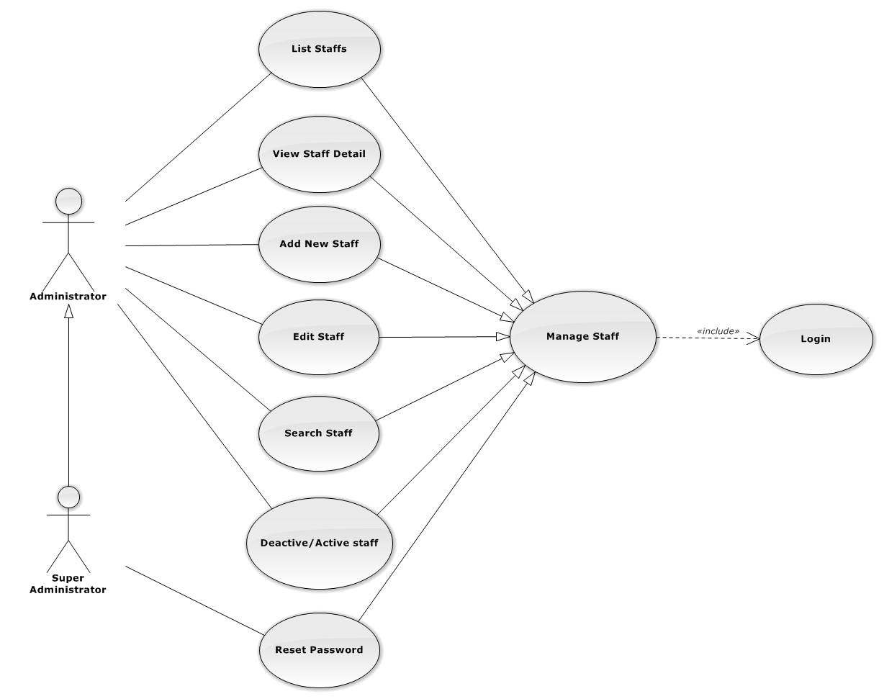
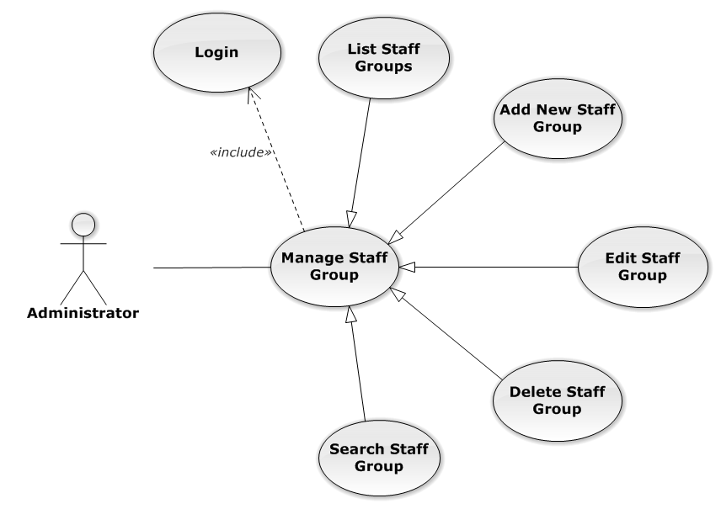
Functional Requirement
Manage Staff
Manage Staff Group

Slide 28
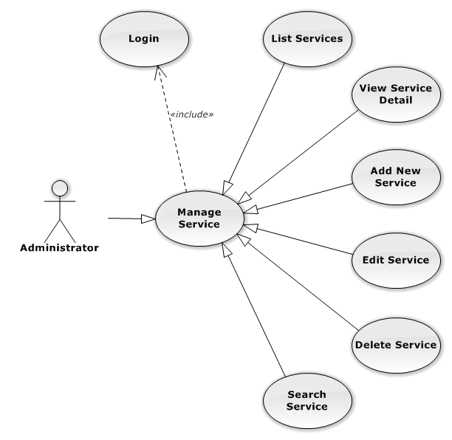
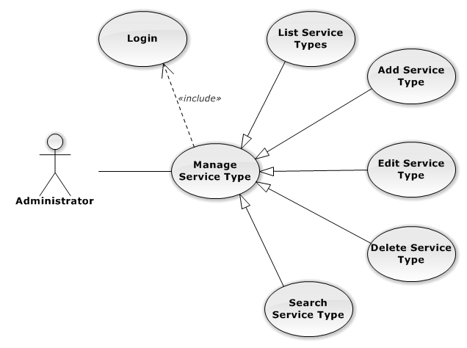
Functional Requirement
Manage Service
Manage Service Type

Slide 29
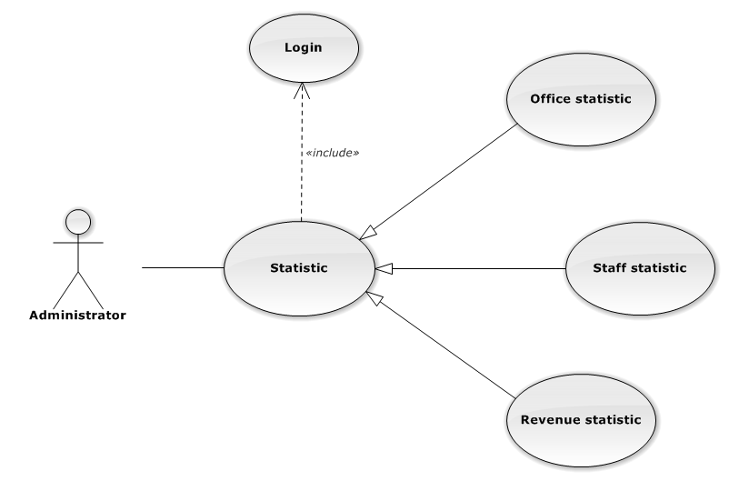
Functional Requirement
Statistic

Slide 30
Non Functional Requirement
Learnable
The user interface must be easy to learn, even at the first time looking at the screen, user may immediately understand the function of each button or icon.
Efficiency
The user interface must minimize the number of steps that the system takes to complete its task.
Memorable
System contains some complex screens. Therefore, interface should be easier to use each time the user interacts with it.

Slide 31
Non Functional Requirement
Visibility
Important information (example: text in nodes) should be clearly visible.
Consistency
Like-items should always be displayed and act the same way through the entire application

Slide 32

Architecture Overview
Package Design
Entity Relationship
SOFTWARE
DESIGN

Slide 33
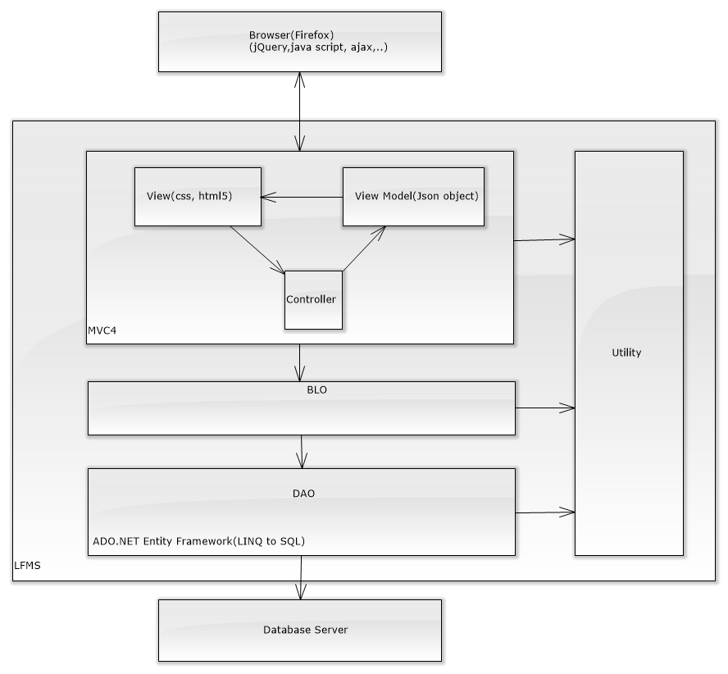
Architecture Overview

Slide 34
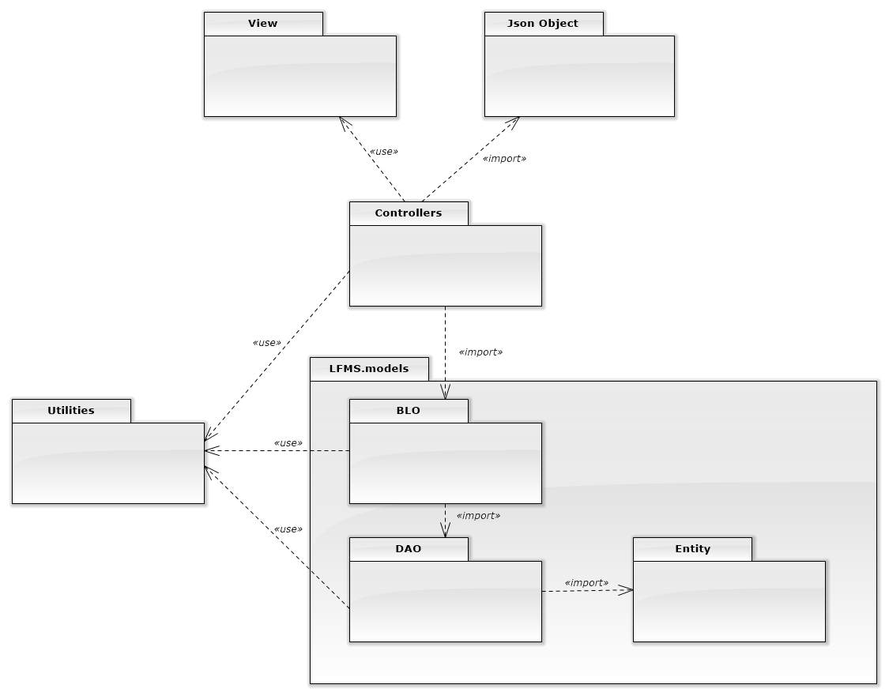
Package Diagram

Slide 35
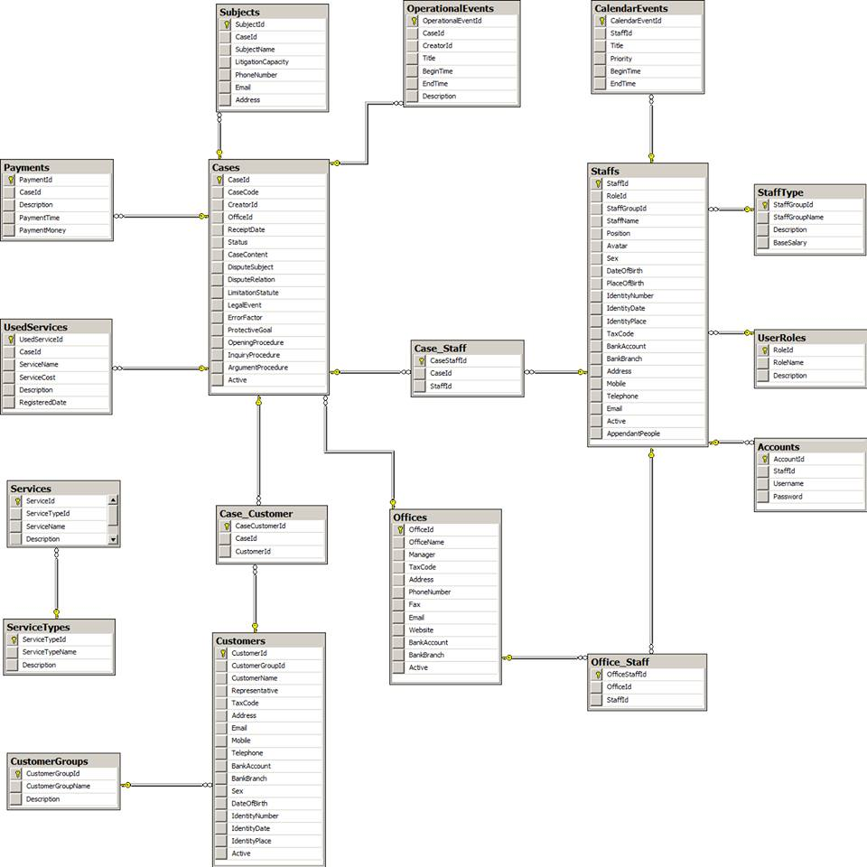
Database Design

Slide 36

Test Model
Test Process
Test Result
Testing

Slide 37
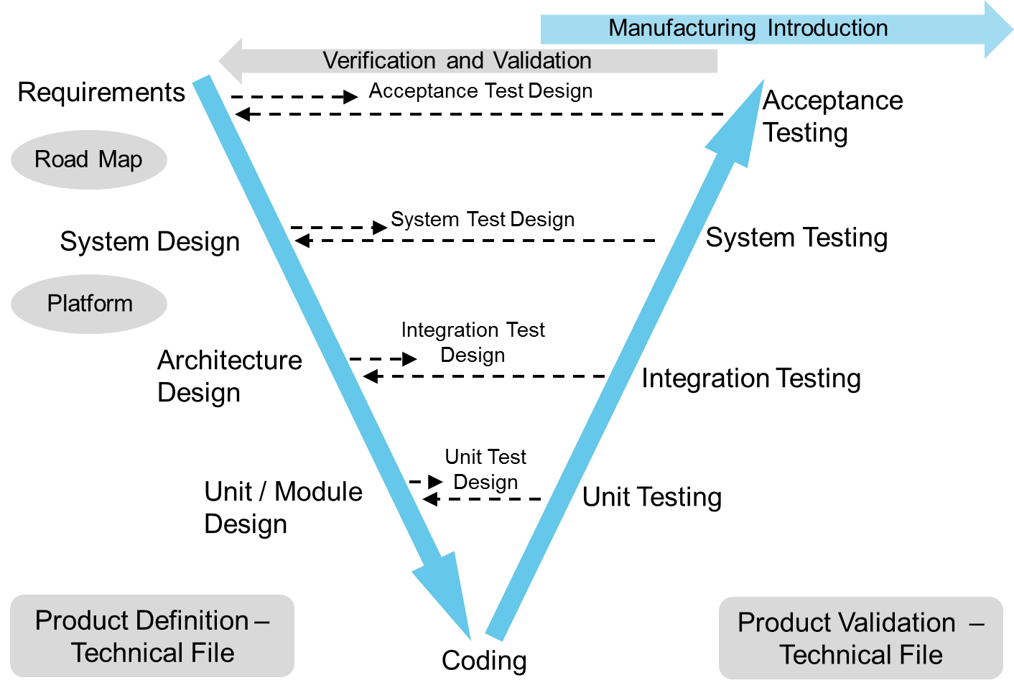
Test Model

Slide 38
Test Model
Simple and easy to use
Why choose
V-Model
Testing activities like planning, test designing happens well before coding
Pro active defect tracking
Avoids the downward flow of the defects
Works well for small projects where requirements are easily understood

Slide 39
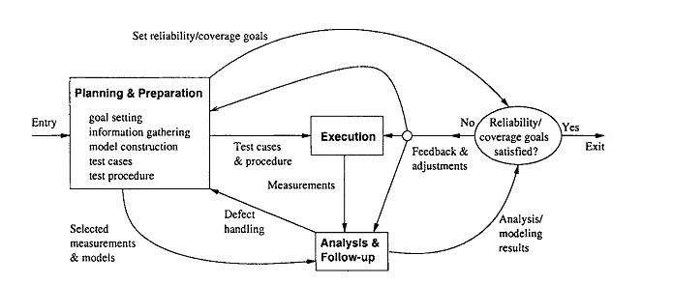
Test Process

Slide 40
Test Process
Goal setting: test stages, test item etc…
Planning & Preparation
Test cases preparation
Test procedure preparation
Executing test
Execution
Related activities: retest, report etc...

Slide 41
Test Process
Analysis & Follow up
Checking result
Analysis result

Slide 42
Test Schedule
Unit test
Doer : Developer
Time : 7/11 – 5/12
Intergration test
Doer : Test team
Time : 17/11 – 2/12
System test
Doer : Test team
Time : 3/12 – 5/12

Slide 43
Test Result

Slide 44

Project result
Comparison Result
Lesson Learned
PROJECT
RESULT

Slide 45

Project Result
We have more experiences of managing a software project: how to manage plan, time, and risk. These experiences help us a lot in our future work.
Know how to communicate with other team members and how to do teamwork efficiently
If this application is developed, we will get a good mark in Capstone Project. It makes our grade better.

Slide 46
Compilation Result
Main objectives | Create a website for law firm that help lawyers can work more effective, easier and simpler way without remember schedule and operation event
Purpose | Law firm can manage all information like case, customer, staff service and office easier
Items | Plan | Actual
Releases date | 17/12/2014 | 17/12/2014
Releases version | 1.0 | 1.0
Days | 100 | 100
Test cases + checklists
Defects
Document pages | 200 | Approximately 500
Lines of code |  | Approximately 50.000

Slide 47
Limitation & Expectation
Limitation
Can not use Android App
Some functions are not smooth as expected
Expectation
Can use Android App
Can locate by GPS

Slide 48
Lesson Learned
Situation | Problem | Lessons learned
Conflict in team | Members are stress Cannot make decision | Talk and listen to each other Analysis situation Make right decisions
Technical difficulties | Take lots of time to solve Miss the deadline | Search in Google or some IT forums Ask group’s supervisor or teachers for some advices

Slide 49


Slide 50


Slide 51
Thanks for watching

